Slide 1
Workshop B: The Whole Child
Monday 1st July, 2019
Karsten Stephan

Slide 2
Aims of this session:
To evaluate and discuss the extent to which the current curriculum meets the needs of the whole child.
To reflect on the ways in which curriculum development and different curriculum models might take greater account of these needs.
To identify concrete steps we can take in our own schools to increase our focus on ‘the whole child’.

Slide 3
Stimulus 1: Pink Floyd, ‘Another Brick in the Wall’

Slide 4
The Wider Context
Key judgements made in the New Framework:
Inspectors will also make graded judgements on the following areas using the four-point scale:
quality of education
behaviour and attitudes
personal development
leadership & management

Slide 5
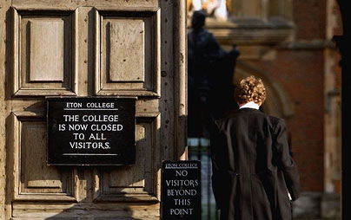
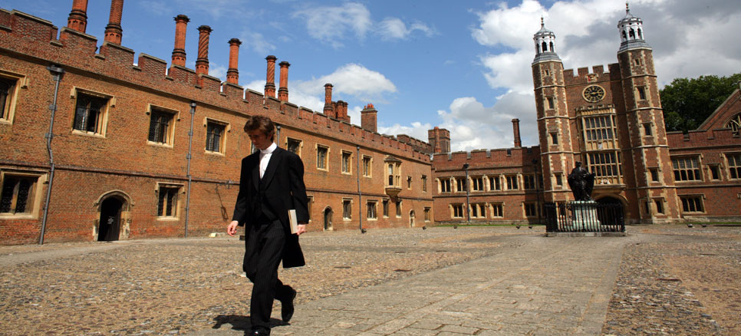
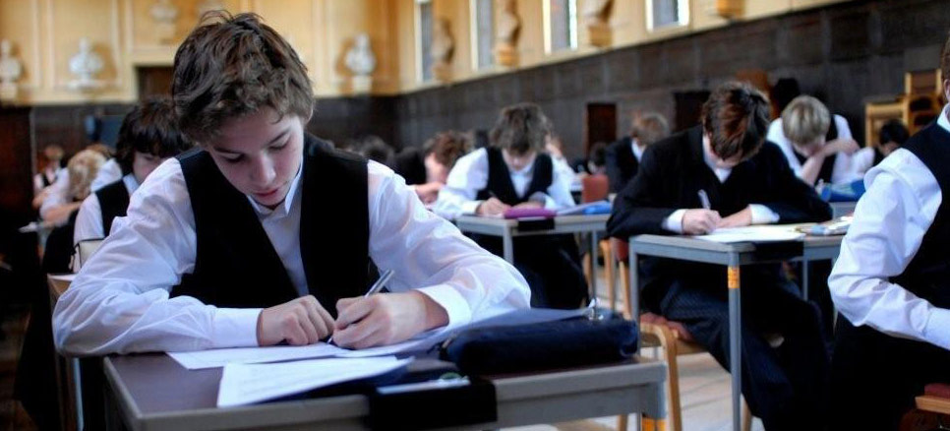
DISCUSSION: What did Tony Little, former Head of Eton College, say was the main difference in the curriculum between his school and the state sector?
AIMS :To evaluate and discuss the extent to which the current curriculum meets the needs of the whole child.
To reflect on the ways in which curriculum development and different curriculum models might take greater account of these needs.
To identify concrete steps we can take in our own schools to increase our focus on ‘the whole child’.

Slide 6
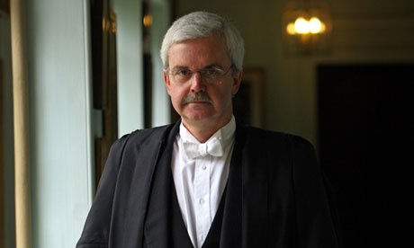
THE KEY DIFFERENCE: Not the quality of teaching and learning but the emphasis on extra-curricular activities
Tony Little: Former Head of Eton School
..he believed that most of his pupils learnt more from "what's not happening in the classroom", a reference to the wide range of extra-curricular activities that offered a broader education than the exam syllabus alone.
1 Encourage them to aim high
2 Celebrate their diverse, individual achievements
3 Give them genuine responsibility to take the lead
4 Allow them to fail and learn from the experience
5 Don’t treat them all the same way, and show them understanding
AIMS :To evaluate and discuss the extent to which the current curriculum meets the needs of the whole child.
To reflect on the ways in which curriculum development and different curriculum models might take greater account of these needs.
To identify concrete steps we can take in our own schools to increase our focus on ‘the whole child’.

Slide 7
The new OFSTED Framework From September 2019
Personal development
Inspectors will make a judgement on the personal development of learners by evaluating the extent to which
the curriculum extends beyond the academic, technical or vocational. It provides for learners’ broader development, enabling them to develop and discover their interests and talents
the curriculum and the provider’s wider work support learners to develop their character – including their resilience, confidence and independence – and help them know how to keep physically and mentally healthy
at each stage of education, the provider prepares learners for future success in their next steps
the provider prepares learners for life in modern Britain by:
– equipping them to be responsible, respectful, active citizens who contribute positively to
society − developing their understanding of fundamental British values
− developing their understanding and appreciation of diversity
− celebrating what we have in common and promoting respect for the different protected
characteristics as defined in law.
AIMS :To evaluate and discuss the extent to which the current curriculum meets the needs of the whole child.
To reflect on the ways in which curriculum development and different curriculum models might take greater account of these needs.
To identify concrete steps we can take in our own schools to increase our focus on ‘the whole child’.

Slide 8
‘Something needs to change – for the good of the children’ John Bryant, Headteacher – Arthur Bugler Primary School, Essex
AIMS :To evaluate and discuss the extent to which the current curriculum meets the needs of the whole child.
To reflect on the ways in which curriculum development and different curriculum models might take greater account of these needs.
To identify concrete steps we can take in our own schools to increase our focus on ‘the whole child’.

Slide 9
The importance of personal development ….
Intelligence plus character – that is the goal of true education. The complete education gives one not only power of concentration, but worthy objectives upon which to concentrate. Martin Luther King Jr, ‘The purpose of education’
Rab Butler, the architect of universal education in England, claimed that the rationale behind the 1944 Education Act was to develop ‘our most abiding assets and richest resources – the character and competence of a great people’
Aristotle argued that the ‘good life’ – a life in which humans ‘flourish’ to the greatest extent possible – is achieved by developing good character through acting in accordance with a series of moral virtues such as courage, temperance, generosity…….
AIMS :To evaluate and discuss the extent to which the current curriculum meets the needs of the whole child.
To reflect on the ways in which curriculum development and different curriculum models might take greater account of these needs.
To identify concrete steps we can take in our own schools to increase our focus on ‘the whole child’.

Slide 10
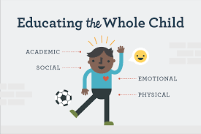
DISCUSSION: how does our existing curriculum develop the whole child?
Strategies used by schools with a strong focus on character:
a whole school ethos
student-led recording evidence of personal development, accompanying school-led approaches to measure character
use of reward or award systems schemes
structured reflection periods
personal tutors or coaches
older students working with younger students
opportunities to take part in voluntary programmes and social action in school and in the local community
consideration of moral issues in a cross-curricular manner
involvement of parents, guardians and families
classes in public speaking, philosophy and ethics lessons
AIMS :To evaluate and discuss the extent to which the current curriculum meets the needs of the whole child.
To reflect on the ways in which curriculum development and different curriculum models might take greater account of these needs.
To identify concrete steps we can take in our own schools to increase our focus on ‘the whole child’.

Slide 11
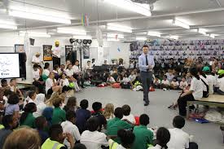
Designing a curriculum based on the whole child:
The three founders of School 21 Peter Hyman, Oli de Botton and Ed Fidoe came together with a shared belief that education must be done differently if we are to prepare young people properly for the world they are going into.
Their conviction was that we needed schools to rebalance head (academic success), heart (character and well-being) and hand (generating ideas, problem solving, making a difference). https://www.school21.org.uk/
AIMS :To evaluate and discuss the extent to which the current curriculum meets the needs of the whole child.
To reflect on the ways in which curriculum development and different curriculum models might take greater account of these needs.
To identify concrete steps we can take in our own schools to increase our focus on ‘the whole child’.

Slide 12
School 21 – Newham, East London
John Pardoe, Senior Leader, Curriculum and Assessment Innovation, School 21, Newham, London
“Too often schools see students as blank books that need to built up into something….but my view of education is that..as teachers we are interacting with students as whole people, who have their own histories, thoughts and ideas.”
Lead, NEU Summer 2019
Year 7: 60% time in traditional lessons, 25 per cent on projects and 15% on coaching
The projects are negotiated with students – they become key stakeholders in the
curriculum
AIMS :To evaluate and discuss the extent to which the current curriculum meets the needs of the whole child.
To reflect on the ways in which curriculum development and different curriculum models might take greater account of these needs.
To identify concrete steps we can take in our own schools to increase our focus on ‘the whole child’.

Slide 13
DISCUSSION: How do we innovate and change our curriculum to meet the needs of the whole child?
Two different models:
Establish key values and skills which address the needs of the whole child and design an ‘ entitlement’ curriculum around these
Working from the needs of the individual child, developing a curriculum to meet these needs.
AIMS :To evaluate and discuss the extent to which the current curriculum meets the needs of the whole child.
To reflect on the ways in which curriculum development and different curriculum models might take greater account of these needs.
To identify concrete steps we can take in our own schools to increase our focus on ‘the whole child’.

Slide 14
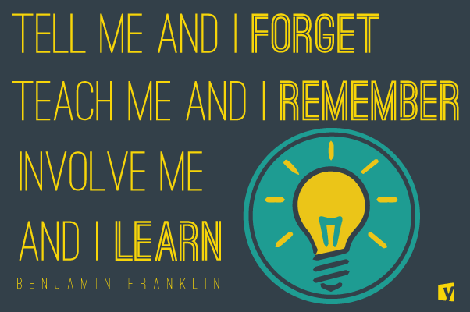
The importance of student engagement
AIMS :To evaluate and discuss the extent to which the current curriculum meets the needs of the whole child.
To reflect on the ways in which curriculum development and different curriculum models might take greater account of these needs.
To identify concrete steps we can take in our own schools to increase our focus on ‘the whole child’.

Slide 15
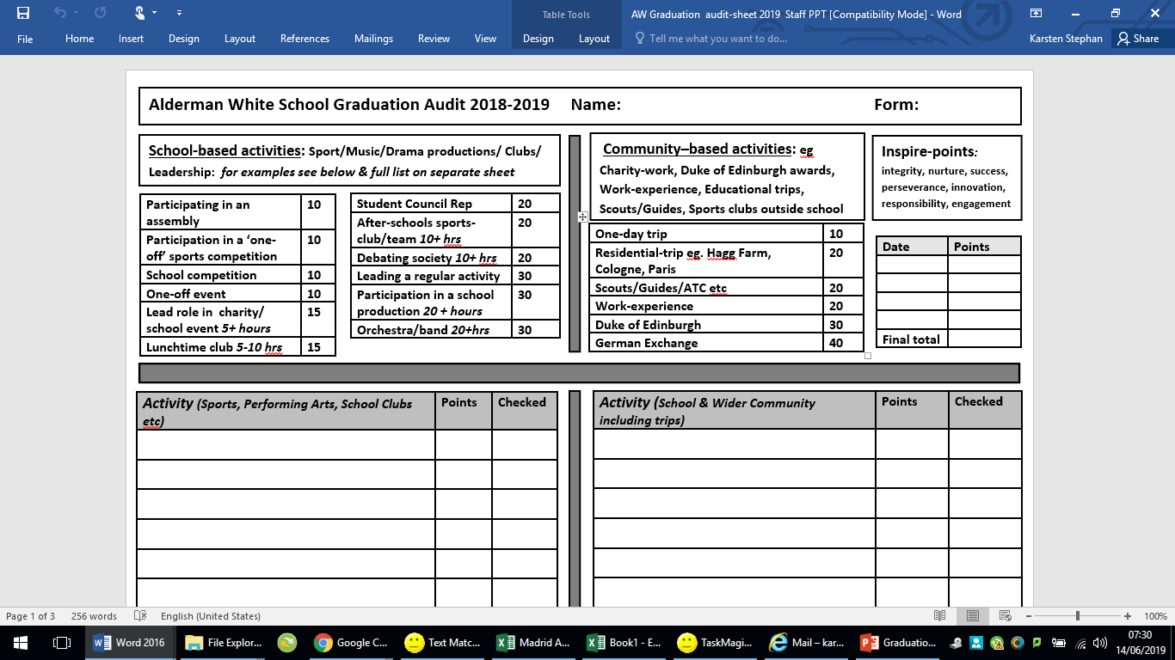

Slide 16
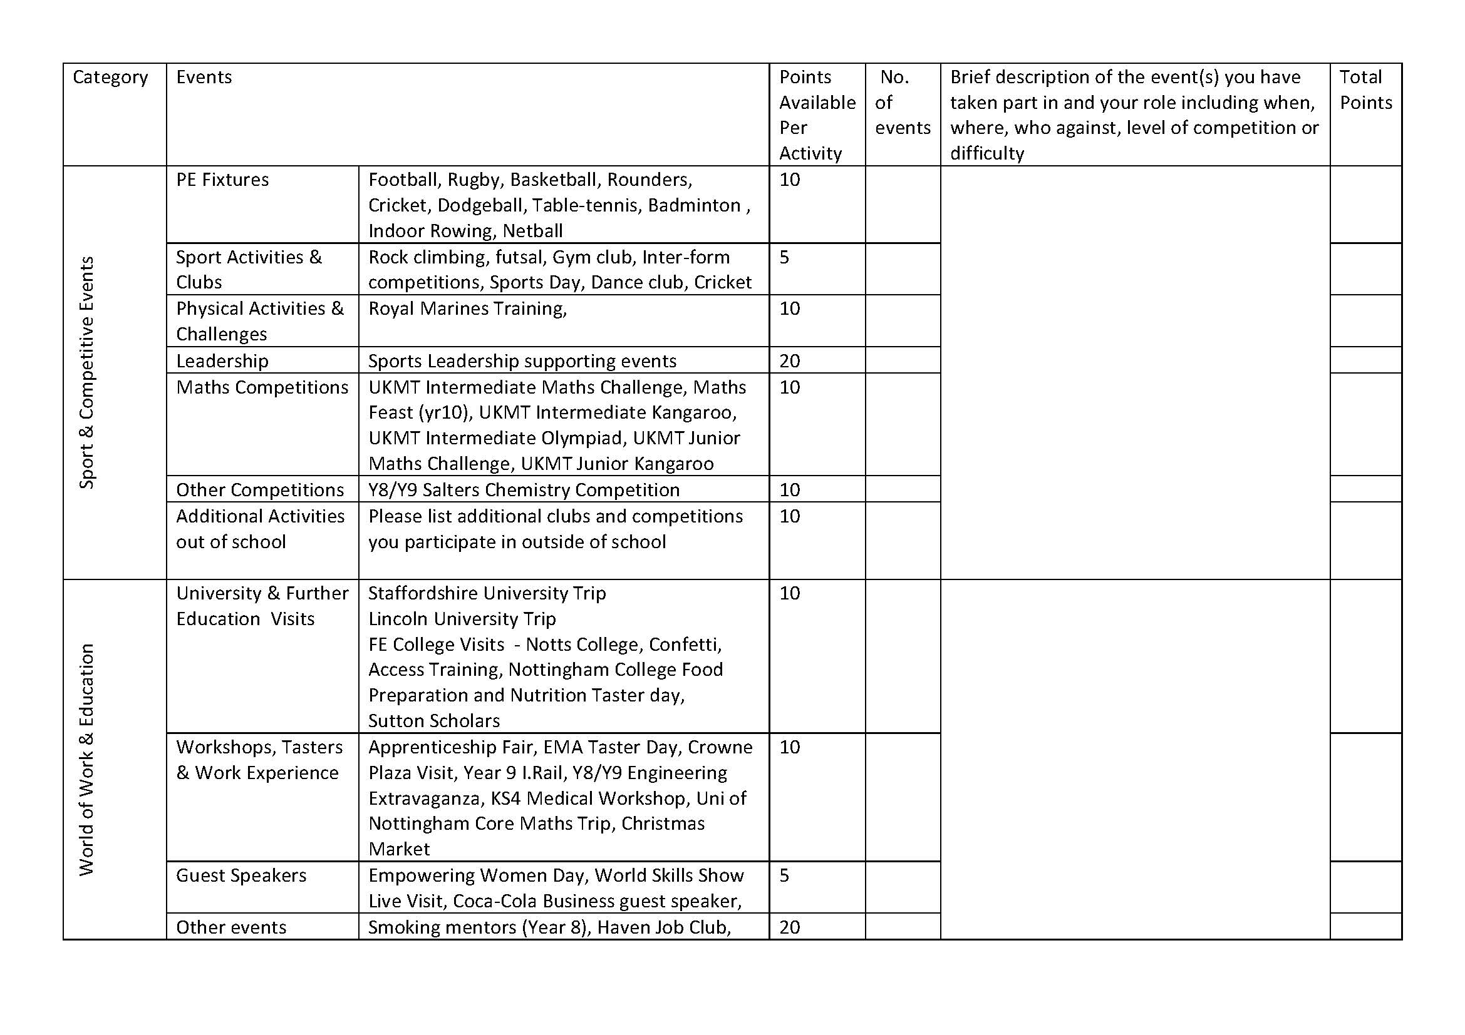
Bramcote College Graduation Audit – Simon Morton
AIMS :To evaluate and discuss the extent to which the current curriculum meets the needs of the whole child.
To reflect on the ways in which curriculum development and different curriculum models might take greater account of these needs.
To identify concrete steps we can take in our own schools to increase our focus on ‘the whole child’.

Slide 17
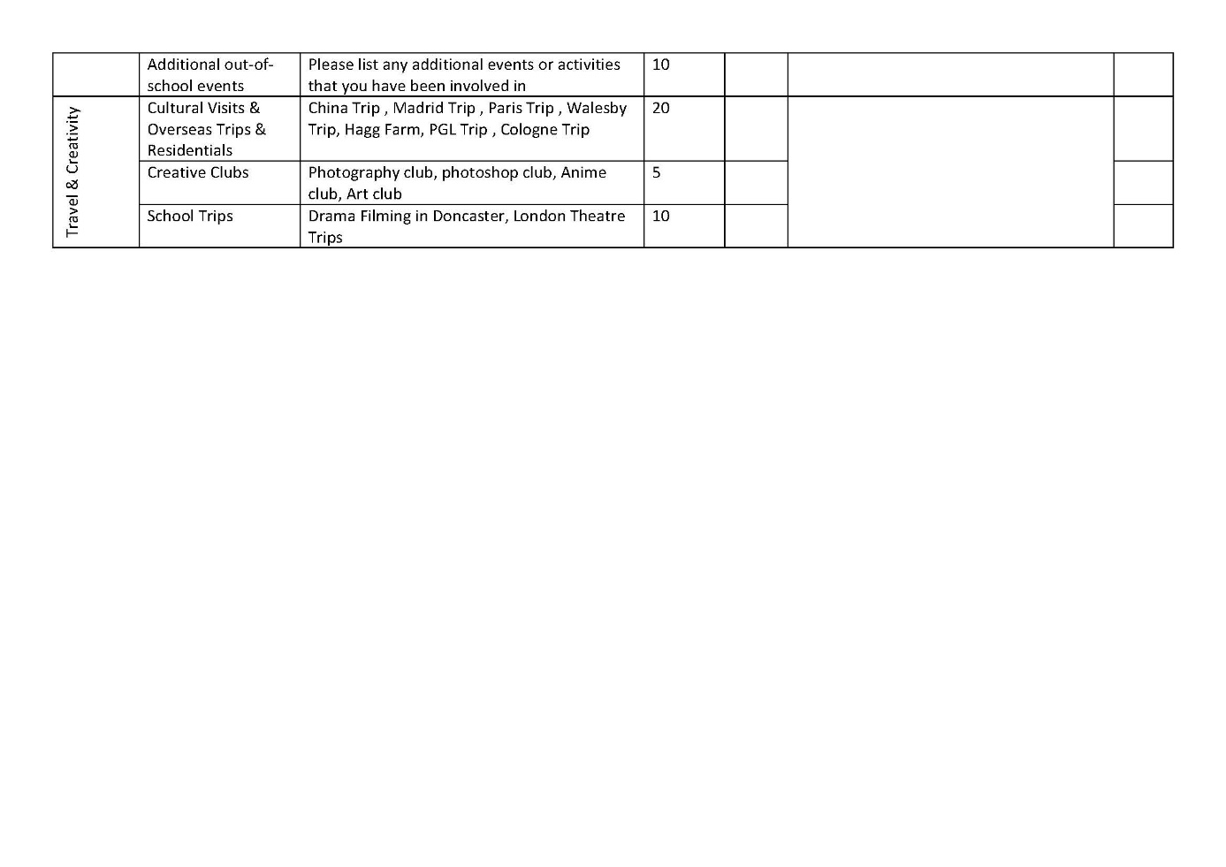
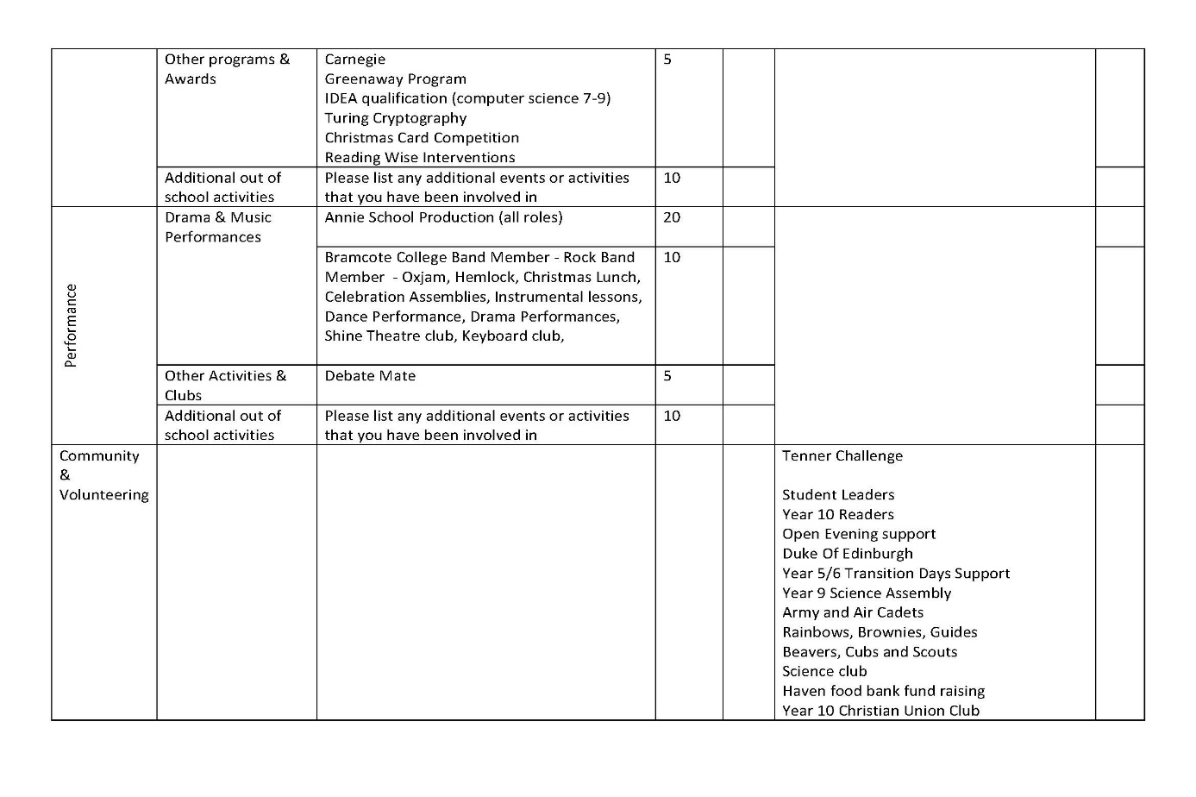
Bramcote College Graduation Audit – Simon Morton
Identifying and auditing key areas of experience
AIMS :To evaluate and discuss the extent to which the current curriculum meets the needs of the whole child.
To reflect on the ways in which curriculum development and different curriculum models might take greater account of these needs.
To identify concrete steps we can take in our own schools to increase our focus on ‘the whole child’.

Slide 18
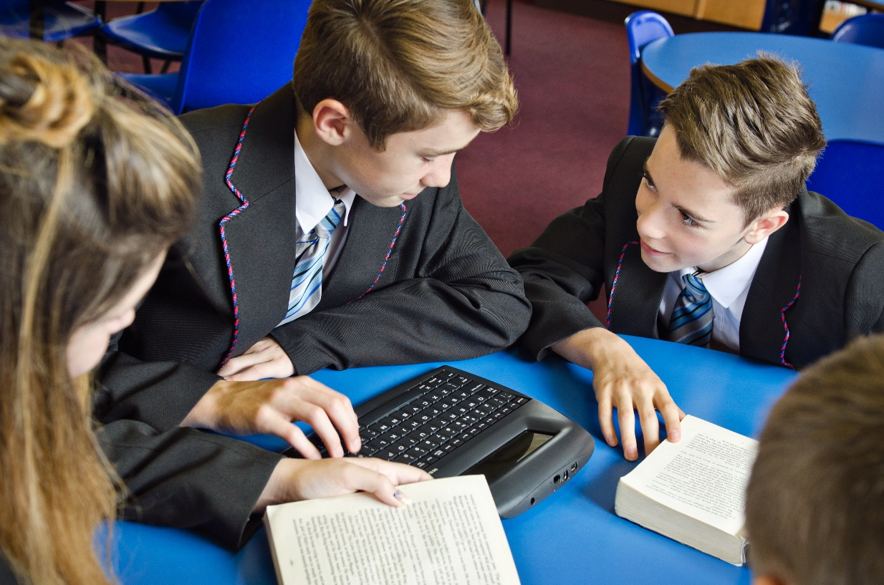
DISCUSSION: What concrete steps can we take to increase the focus on the ‘whole child’ in our schools or in our classrooms?
AIMS :To evaluate and discuss the extent to which the current curriculum meets the needs of the whole child.
To reflect on the ways in which curriculum development and different curriculum models might take greater account of these needs.
To identify concrete steps we can take in our own schools to increase our focus on ‘the whole child’.

Slide 19
Tell me what have you done today to feel proud – Heather Small
AIMS :To evaluate and discuss the extent to which the current curriculum meets the needs of the whole child.
To reflect on the ways in which curriculum development and different curriculum models might take greater account of these needs.
To identify concrete steps we can take in our own schools to increase our focus on ‘the whole child’.

